Slide 1


Welcome to our presentation
1

Slide 2

Group Name: Flower
Group members:
Tamanna Akter (221-15-5298)
Binota Roy (221-15-5337)
Nahida Akter (221-15-4711)
Section : 61_M
Department of CSE

Slide 3

Project Title: Hospital Management System

Slide 4

Contents:
Introduction
Objectives
Features
Data Structures
Functions
Result (Screen Short)
Technologies Used
Workflow diagram
Future Scope
Challenges and Lessons Learned
Project Overview/Summary
Limitations of the Project
Conclusion

Slide 5


Introduction
Hospital Management System Project

Slide 6

Project Objective
To manage patient and doctor records effectively.
Ensure efficient memory management and error handling.
Create a user-friendly interface.
Demonstrate the use of data structures.

Slide 7
Features
Patient Management:
Doctor Management:
Add
Delete
Update
Search by ID.

Slide 8
Data Structure Used
Structure
Array
Linked List

Slide 9

Functions:
Create
Insertion
Deletion
Search
Update
Display
main
Exit
Others conditional statement

Slide 10
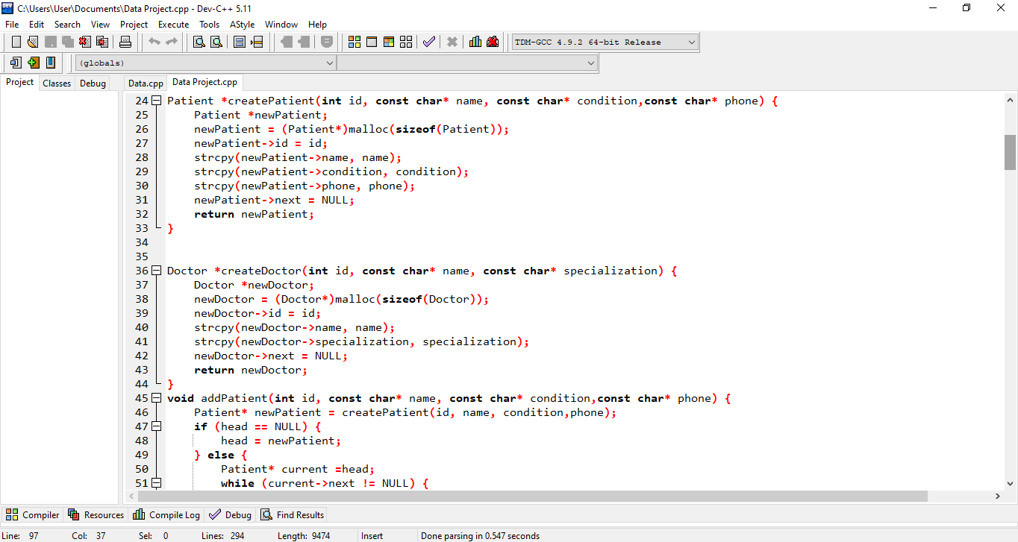

Slide 11
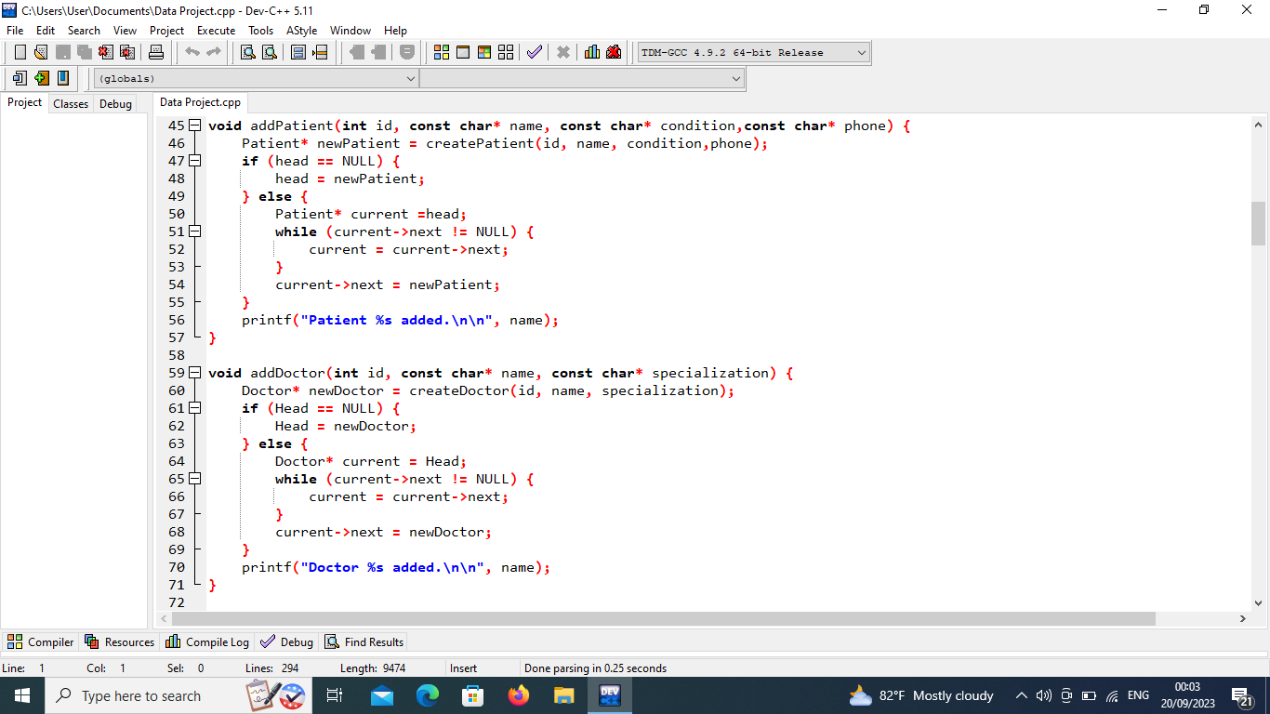

Slide 12
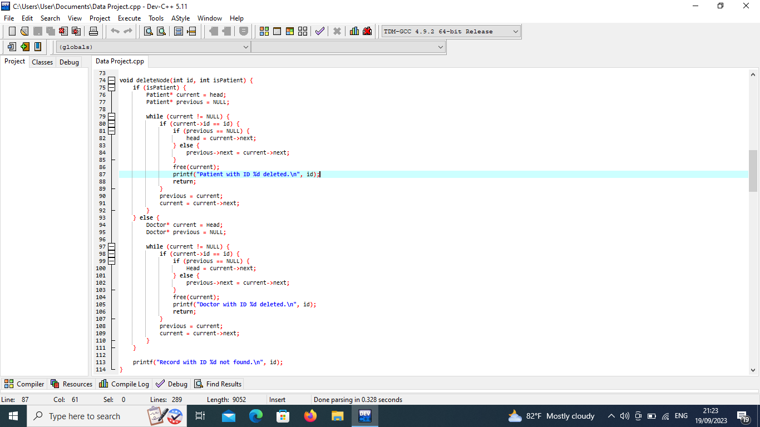

Slide 13
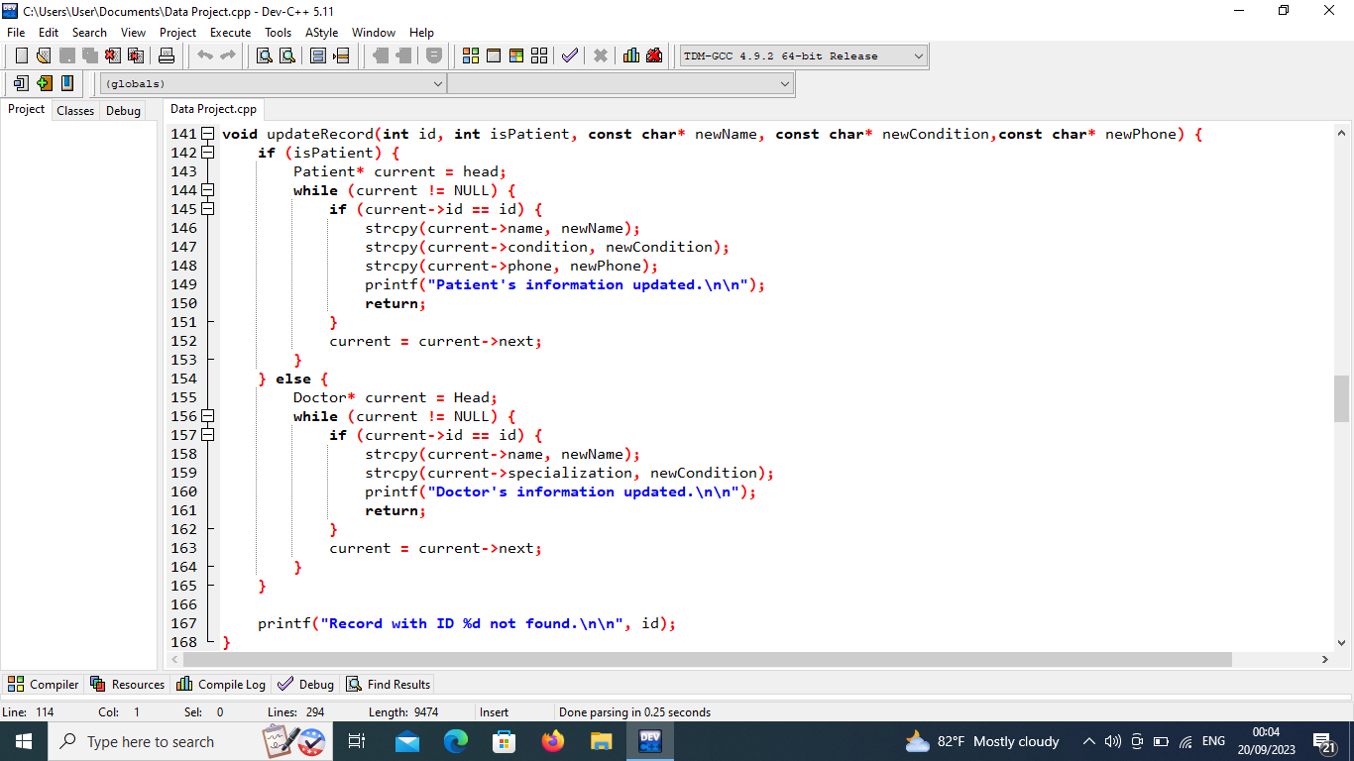

Slide 14
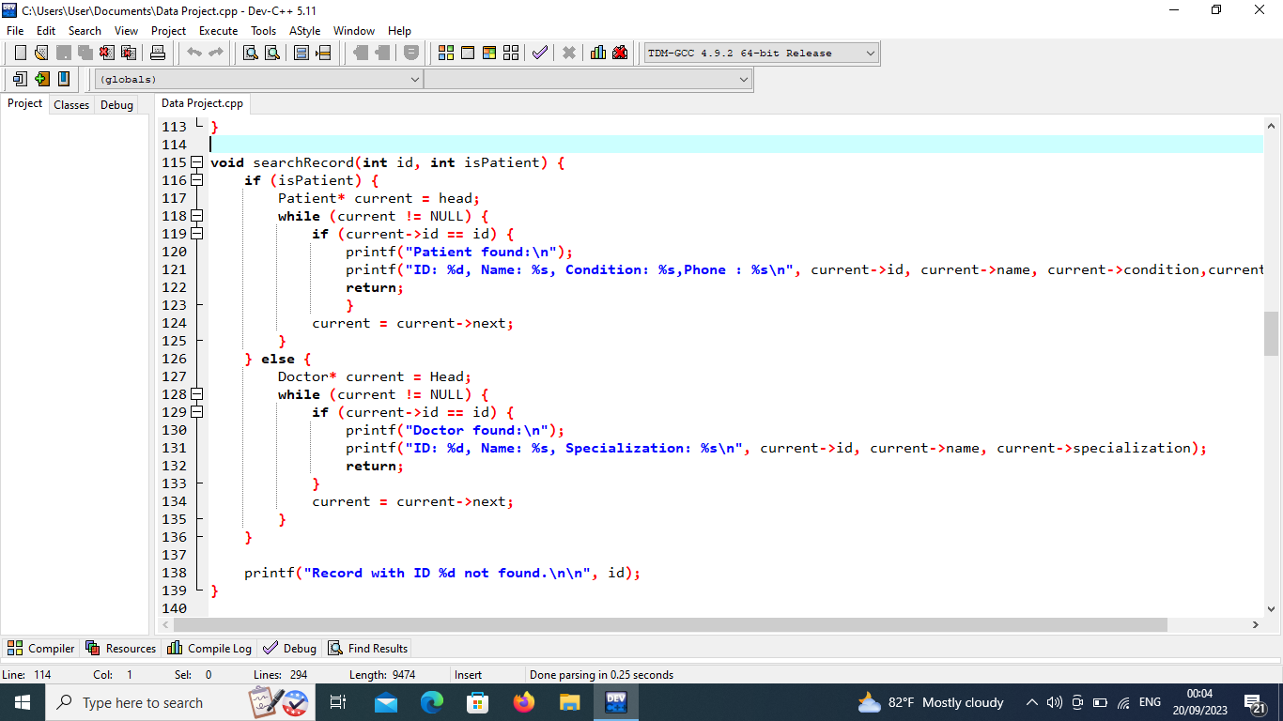

Slide 15
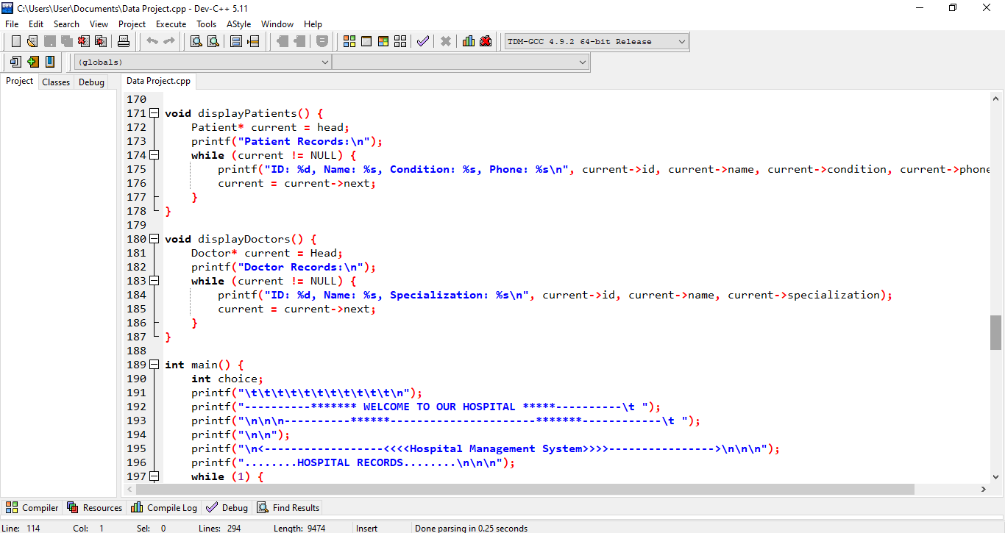

Slide 16
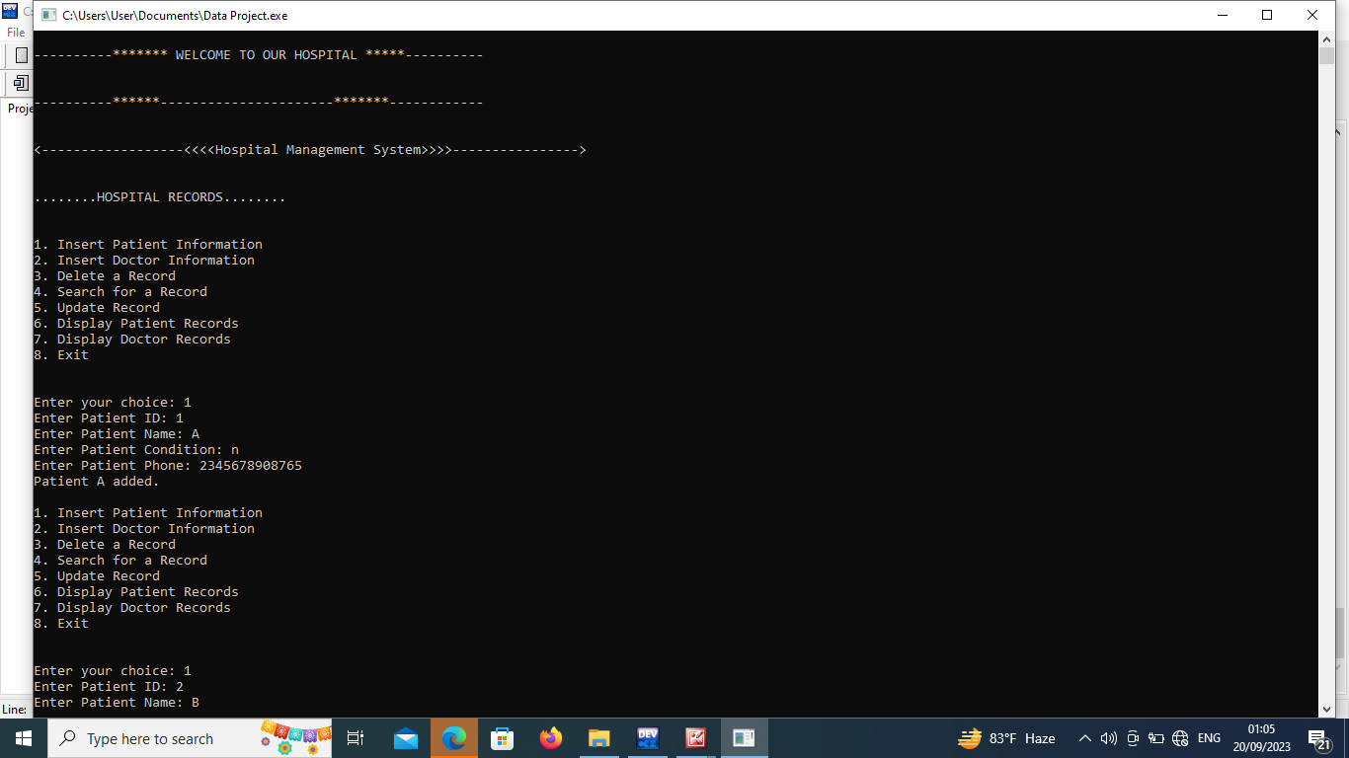
Output

Slide 17



Technologies Used:

Slide 18
Workflow diagram
Start
Menu
Choose
Exit
Perform selected action
Return menu

Slide 19

Future Scope
Database Integration
Additional Functionalities
Security Enhancements
User Interface Improvement
Web or Mobile Application

Slide 20

Challenges :
Data Structure Implementation
Dynamic Memory Management
User Interface Design
Error Handling
Testing and Debugging

Slide 21

Limitations of the Project
Lack of security features
Lack of persistent data storage
Limited error handling
Limited functionality

Slide 22

Project Overview/Summary

Slide 23


Slide 24


